Slide 1
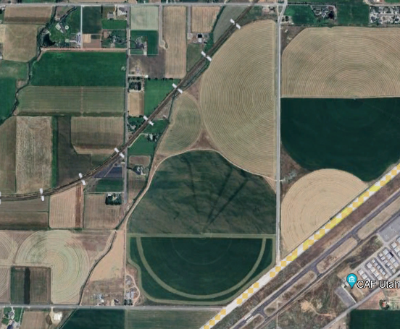
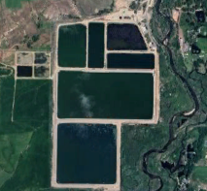
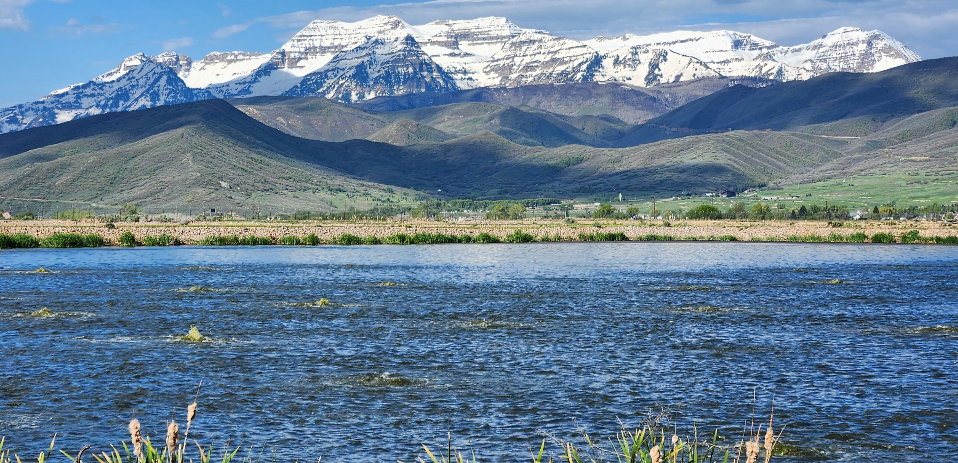
HVSSD Facility Planning Discussion June 13, 2024

Slide 2
Current Capacities
Facility/Process | Nominal Capacity (MGD)
Treatment Lagoons | 2.43 (1.43 Cell1, 1.0 Cell 1A)
Winter Storage Lagoons | 1.96
Land Application Site | 1.85
Mechanical Plant | 2.0 (design) /1.5 (estimated)
Rapid Infiltration Basins | 2.0
Plant Design Capacity | 4.43
Plant Firm Capacity 2024 | 3.35
Average Daily Flow 2024 | 2.18

Slide 3
Flow Projections vs Capacity

Slide 4
Address short-term capacity needs =CIB Project
Bridge the gap between firm and design capacity
Roughly a 10-year solution
Contemplated prior to major odor concerns/public complaints
Did not consider screens/headworks project
Assumed capacity of mechanical plant was 1 MGD (50% of design)
Does not appear to consider long-term planning- post 2040/2050

Slide 5
CIB Mechanical Upgrade
~3.0 MGD Capacity (2 trains @ 1.5 MGD each)
4.85 MGD Combined Capacity w/ Lagoons
High odor potential
Growing nearer to neighbors
Requires RIBs expansion – add 1 MGD
Continue to operate and maintain lagoons
Cost estimated >$50M
Increased O&M
Original mechanical plant nearing 30 years old- exceeding service life
Meets needs to approx. 2040 (10-Year solution)
Site Constraints/Boxed In - Where do we go from here?
Property Line
Anaerobic Digesters and Support Building
Solids Dewatering and Loadout
Solids Holding/ Blending Tanks
Blowers/Pumps Building
Secondary Clarifier #3
Mechanical Aeration Upgrade 1.5 MGD
Primary Clarifier #2
HP&L
Island Ditch

Slide 6
CIB Project Reconsideration
Reduce the scope of CIB project to necessary near-term projects next 5-10 yrs
Original |  | Proposed
Project | Cost Opinion | Project | Cost Opinion
Midway Lift Station | $639,000 | Midway Lift Station | $1,250,000
New Farm Shop | $699,000 | Generator | $160,000
Laboratory Building | $620,000 | Headworks Upgrade | $1,700,000
Generator | $160,000 | Aeration Upgrade (Lagoon) | $1,500,000
Mechanical Plant Aeration Upgrade | $12,470,000 | Lagoon Dredging? | $6,000,000
Blowers (Lagoon) | $600,000
Aeration Piping (Lagoons) | $450,000
Total Cost | $15,638,000 | Total Cost (w/ Dredging) | $9,260,000
 |  | Total Costs (w/out Dredging) | $3,260,000

Slide 7
Addressing Long-Term Needs
What happens after the CIB project?
Lagoon/Land Application System
Significant Expansion is Unlikely
Maintain current system/capacity
Age -nearly 45 years of service
What is the fate of the lagoons and land application?
Increasing Capacity = Mechanical Plant Expansion
Expand existing system?
Build a new parallel system?
Go all mechanical treatment?

Slide 8
Addressing Long-Term Needs – Effluent Disposal
Land Application
Current System at Capacity
Limited opportunity for significant expansion
RIB’s
Planned expansion to double capacity to 4 MGD
District owns land
Regulatory uncertainty with expansion
Stricter limits/requirements, anti-degradation
Reuse – Type 1
Water Rights Challenges
Public Perception/Acceptance
Advanced Treatment Requirements
Filtration/Membranes
High Level Disinfection
Winter Storage Required
Pumping /Distribution Infrastructure
Provo River
Advanced treatment required- membranes likely
Costly O&M – chemicals and sludge (phosphorus removal)
Public and water user pushback
Other?
Recharge Wells

Slide 9
Addressing Long-Term Needs – Solids Management
District has benefited hugely over the last 40+ years by not having to manage or dispose of solids
Solids management typically accounts for 40-60% of capital and O&M costs at a WRF
It is believed that the practice of disposing sludge from the mechanical plant in Cell 1 has exacerbated odor generation
Conceptual Options
Continue disposal in lagoon – THIS OPTION ASSUMES THE LAGOON IS DREDGED, AERATION IS REPAIRED/UPGRADED AND REGULAR DREDGING OCCURS TO MANAGE SOLIDS ACCUMULATION
Management and Disposal
Solids Stabilization
Class A or Exceptional Quality
Class B
Unclassified
Thickening/Dewatering
Sidestream Management
Disposal
Landfill
Land Apply

Slide 10
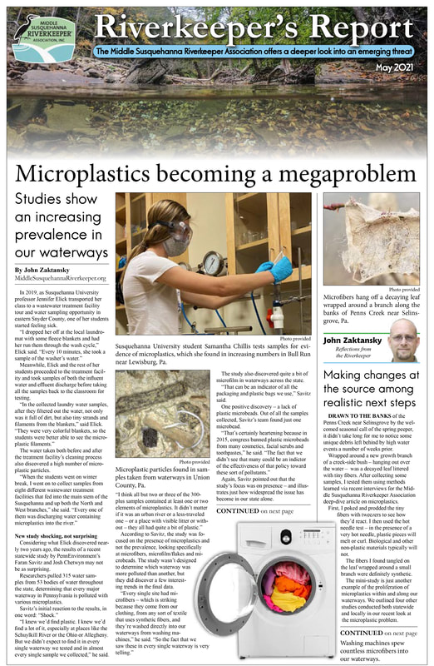
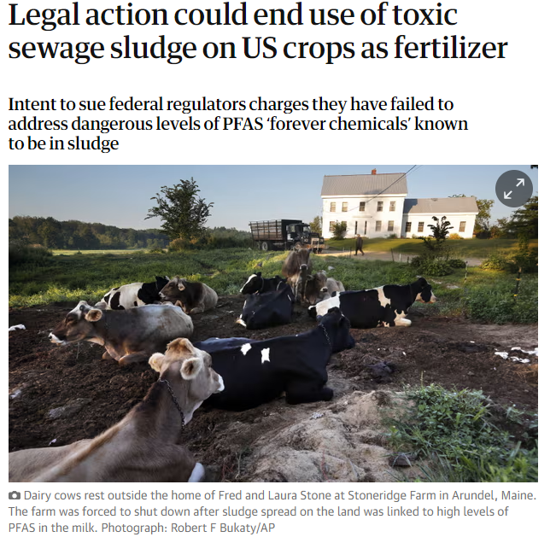
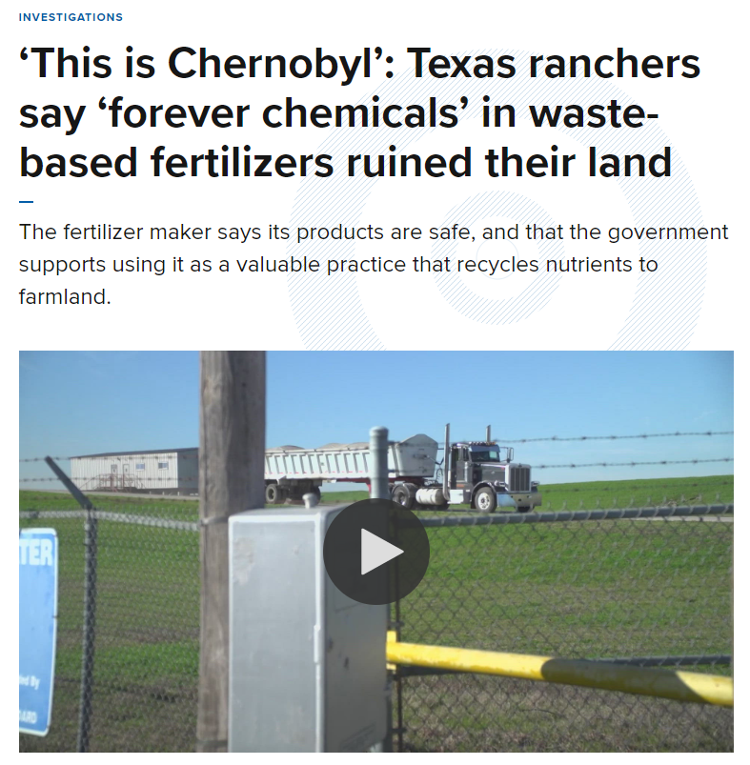
Addressing Long-Term Needs – Emerging Contaminants
Pharmaceuticals, EDC’s
PFAS
Microplastics

Slide 11
Path Forward….
Facility Plan- Comprehensive
Alternatives and costs- liquid and solids treatment
Engage with regulatory agencies
Disposal options and strategy
Board workshops
Public engagement/involvement
Rates and Impact Fees
Funding/financial
Plan costs: $150,000 -$250,000

